Slide 1


Slide 2

Business Environment??
The environment of any organization is “ the aggregate of all conditions, events and influences that surround and affect it.”
In other words , business environment is individual and organisation that exists outside the business and have influence direct and indirect to the business.

Slide 3

Why study Business Environment??
The success of every business depends upon adapting itself to the environment within which it functions.
For Example:
When there is a change in government policies, the business has to make the necessary changes to adapt itself to the new policies.
Change in technology may render the existing products obsolete, introduction of colour T.V television replaced the black and white T.V or introduction of computers replaced type writers. Introduction of Jeans affected traditional wear. Etc.
All these aspects are external factors that are beyond the control of business. Hence it is very important to have a clear understanding of concepts of business environment in order for business units to adapt themselves to the BE.

Slide 4
Importance Of Business Environment
Firm to identify Opportunities and getting the first mover advantage. E.g. Maruti for small cars.
Firms to identify threats and early warning signals. E.g.. Multinational entering the market.
Continuous learning: Environmental analysis makes the tasks of managers easier in dealing with business challenges.
Image Building: By showing their sensitivity towards the environment. E.g. Captive power plants in factories.
Meeting competition: It helps the firms to analyse the competitors strategies and formulate their own strategies accordingly.
Identifying firms strengths and weaknesses.

Slide 5
Features Of Business Environment
Business environment is the sum of all factors external to the business firm and that greatly influence their functioning.
It covers factors and forces like customers, competitors, suppliers, government and the social, cultural, political, technological and legal conditions.
The business environment is dynamic in nature and it keeps on changing.
The changes of business environment are unpredictable. It is very difficult to predict the exact nature of future happenings and the changes in economic and social environment.
Business environment differs from place to place, country to country. Like political conditions in Sri Lanka will differ from those in Pakistan.

Slide 6
Political factors affecting business environment :
Political factors are the factors relating to policies and nature of the government. Some of the factors are :
Taxation Policy
Regulatory framework
Governmental stability
Nature of government’s policies towards business- related to taxation, regulation of business and industry

Slide 7
Examples :
Retrospective taxation and GAAR spooked investors as it was thought that it was a disincentive for companies to do business in India. Therefore, the implementation of GAAR has been postponed to 2016 since the growth rates are already low right now. And this policy might slump the growth further by creating a negative business environment

Slide 8
Economic factors affecting business environment :
Economic factors relate to the general conditions of the economy within which a firm/business operates.
These factors can be :
Inflation
Interest rates
Growth rates
Unemployment levels
Levels of disposable incomes
Whether the country is experiencing boom/recession

Slide 9
Examples :
Increasing disposable incomes would mean that people would have greater demand for products. Therefore, firms would respond to such increasing incomes by expanding their businesses in such areas.
An increase in interest rates would mean increase in borrowing costs for both consumers and firms. Therefore, investments would be curtailed or postponed resulting in lower growth rates for the entire economy

Slide 10
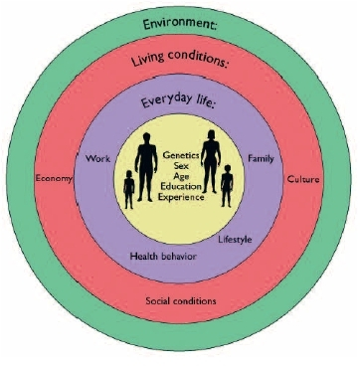
SOCIO-CULTURAL ENVIRONMENT
1.A set of customs, beliefs, behaviour and practices that exists within a population.
2.Companies often include an examination of socio-cultural environment before entering their target markets.
Factors which affect socio-cultural environment
1.Demographic factors
2.Attitude of people
3.Social responsibilities
4.Religion
5.Taste & Preference
6.Education
7.Family
8.Natural & Technological factors
9.Income & Lifestyle

Slide 11
1.Language : Sometimes a firm faces language problems like ford faced when they introduced their truck brand named ‘fiera’ which means ugly old woman in Spanish.
2.Taste & Preference : Taste & preference of a consumer also affects a product’s demand, so companies have to modify their product accordingly.
3. Dressing & Lifestyle: These factors also impact the demand for a product.
4.Religion : Religious aspects also play a important role in creating & deteriorating the demand for a product.

Slide 12
A company which benefited due to socio cultural environment
McDonalds made segment according to the demographic.
McDonalds made their food according to religions in India.
McDonalds believed in Total Quality Management.
They offer food at affordable and convenience rates which gives direct benefit to them.

Slide 13
Legal Environment
This refers to the set of laws and regulations which influence the business organisations. The important legislations that concern the business enterprises include :
1.Companies act
2.Foreign exchange management act
4.Consumer protection act
5.Environment protection act
6.Prevention of food adulteration act
7.Minimum wages act
8.Right to information act

Slide 14
Legal factors can limit or change how a business operates. For example :
1.A company may have to hire additional supervisory staff or purchase safety equipment after a new health and safety law is passed.
2. Limited hours a minor can work and require set break periods. If an organization employs several minors, it may have to hire additional help to cover the hours when the minors cannot legally work.

Slide 15
Physical & technological environment
Business prospects demands availability of certain physical facilities
E.g. demand for electrical appliances is affected by the extent of electrification and the reliability of power supply.
Demand for LPG stoves depend on rate of growth of gas connections
Differing technological environment of different markets may call for product modifications
E.g. Many appliances are designed for 110 V in USA. They should be converted for 240v in India
Technological developments may increase or decrease the demand for some existing products
E.g. voltage stabilizers help increase in sale of electrical appliances in markets characterised by frequent voltage fluctuations
Introduction of TVs, Refrigerators, etc. with in-built stabilizers adversely affects the demand for voltage stabilizers.

Slide 16
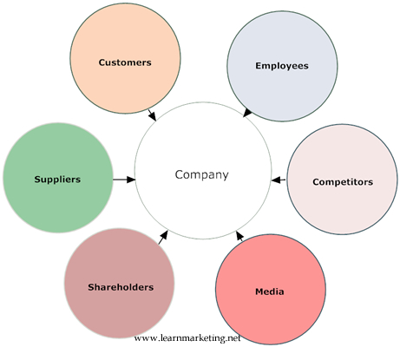
Microenvironment
Microenvironment is an internal part of a company.
These factors can be controlled by the company.
Micro environmental factors have much more direct impact on a business environment.
Some factors are:
Suppliers
Employees
Marketing Intermediaries
Customers
Competitors
Publics

Slide 17
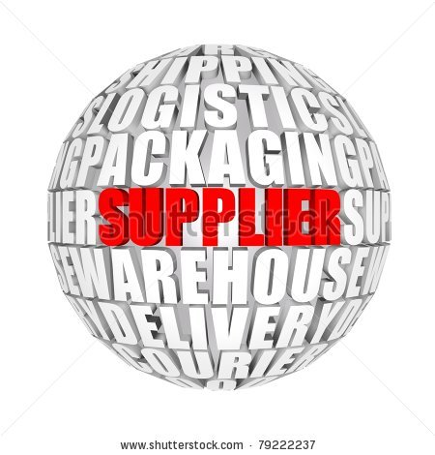
SUPPLIERS
Suppliers provide products and services needed to add value to own product and services.
These services must be provided on time and should meet ones specifications of quality.
If requirements are not met then the production as well as the quality suffers. It also changes the perception of a customer to some extent.
IMPORTANT
A supplier should be reliable.
There should be more than one supplier in a company.

Slide 18
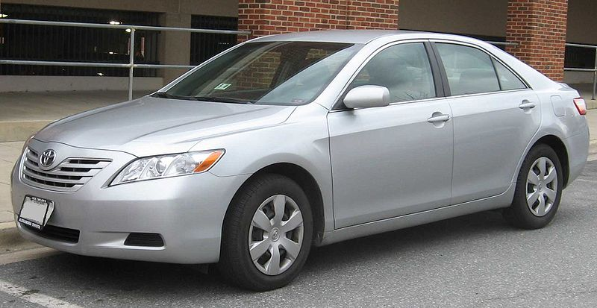
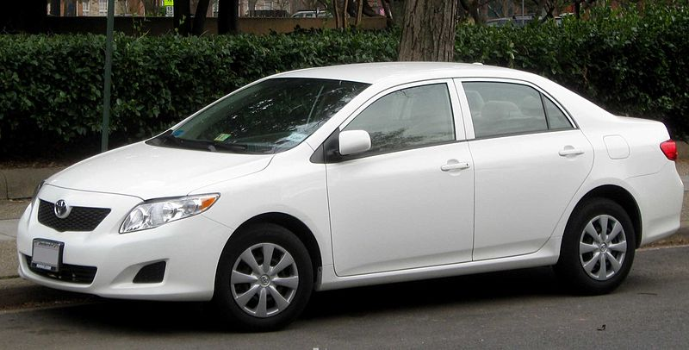
The ‘TOYOTA’ Case
During 2009 – 2011 , Toyota had to recall nearly 10 million vehicles all around Europe as the accelerators were not working properly.
It was because the supplier had supplied faulty mechanical accelerators.
Due to the faulty accelerators there were many accidents out of which nearly 37 were fatal and ended in death.
Out of 10 million cars nearly 7 million were Toyota Camry and Corolla.
Toyota repaired all these cars and sent them back to their owners , but they lost the trust of the customers.

Slide 19
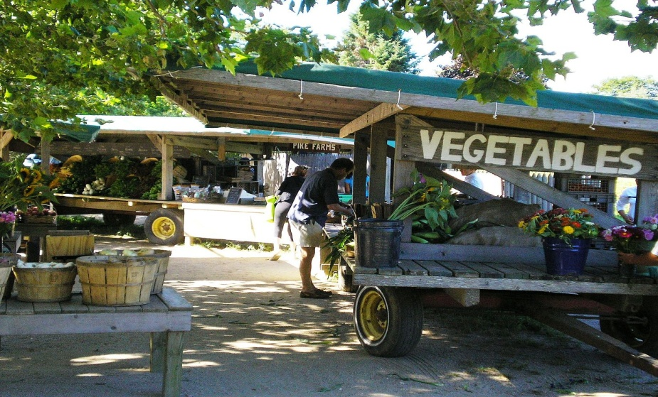
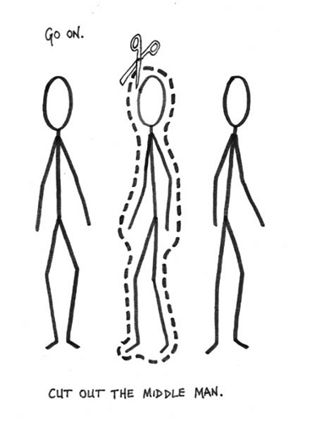
Market Intermediaries
Firms that aid the company in promoting, selling and distributing its goods to final buyers.
Vital links between the company and the final consumers.
Include
The middlemen and merchants who “help the company find customers or close sales with them”
Physical distribution firms which “ assist the company in stocking and moving goods from their origin to their destinations”
Marketing service agencies which “assist the company in targeting and promoting its products to the right markets”

Slide 20
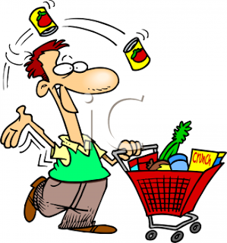

Customers
The company must study its customer markets closely since each market has its own special characteristics.
The least controllable of all.
New customers may be affected by any aspect of your business.
E.g. Toyota cars in year 2002 had issues with its clutch system. They recalled the faulty cars and resolved the issue. It was expected because of this the market share will fall for Toyota but nothing happened. Why??? Because their previous experience with Toyota products or services means they're more likely to opt for Toyota after the problem is resolved.

Slide 21

Competitors
Every company faces a wide range of competitors.
The competitors affect the business's profits by trying to take business away from them.
Their activities affect business’s profits.
No single competitive strategy is best for all companies.
Companies must gain a strategic advantage by positioning their products and services against their competitors in the minds of their customers.
It is all about positioning. Companies have to differentiate itself from your competitors.
If a company provide better products for a lower cost -- and possibly faster -- than its competition, then that comapny can compete with them in ways they may not be able to match.

Slide 22

Publics
Publics are small groups of people who follow one or more particular issue very closely. They are well informed about the issue(s) and also have a very strong opinion on it/them.
In simple terms, a Public is any group of people that may have an real or potential interest in or an impact on your business's ability to achieve its objectives.
Why should you care about Publics? It's simple. Publics can help, or hinder your ability to get your message out to your customers, and collect value from them.
Publics can be categorized to :-
Financial Publics
Media Publics
Government Publics
Local Publics
General Publics
Internal Publics

Slide 23
TECHNIQUES OF ANALYSIS
Verbal & Written Information
Search and Scanning
Spying
Forecasting and Formal Studies

Slide 24

Verbal & Written Information
Verbal information includes, information obtained by direct talk with people, by attending seminars, meetings, etc..
Written or documentary information includes both published and unpublished materials

Slide 25

Search & Scanning
This involves research for obtaining the required information
Search for knowledge and systematic investigation to establish facts

Slide 26

Spying
Working for an organization by secretly collecting information about enemies or competitors.
Even though it is not considered as ethical, spying to get information about the competitor is not uncommon.
Many renowned companies have followed this technique.

Slide 27

12 Ways to Legally Spy:
Read the local papers
Tap your vendors
Go to trade shows
Take a plant tour
Play secret shopper
Browse public documents
Google your competitor's website
Explore LinkedIn
Troll Twitter and Facebook chatter
Find competitors' job ads
See Who's on Quora

Slide 28
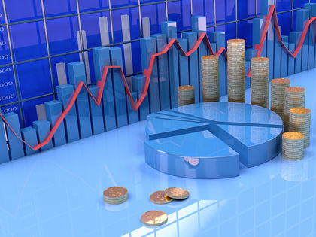
Forecasting & Formal Studying
Forecasting is the process of making statements about events whose actual outcomes (typically) have not yet been observed
Done by corporate planners or other staff personnel or consultants
This pertains to use the information gathered by above mentioned 3 methods for picturing the future scenario.

Slide 29
Forecasting Steps
Identification of Relevant Environmental Variables
Collection of Information
Selection of Forecasting Technique
Monitoring

Slide 30

Thank You

